Slide 1
iOS Application Development
14 Dec 2019
Tokyo

Slide 2
Objectives
Downloading and Installation of iOS SDK
Using iOS SDK
2.1 Xcode
2.2 Simulator
Object Oriented Programming & MVC
Swift Programming (introduction)
iPhone OS (iOS) Architecture
iPhone Application Lifecycle
XCode Templates
UI Elements (UILabel, UIButton, UITextField, …) UIViewController (Demo)
Delegation
Tap, Swipe Gestures (Demo)
Core Location and MAP (Demo)

Slide 3
History
In the 1980s Steve Jobs and Steve Wozniak founded Apple Computer
Steve Jobs out of the company
Steve Jobs started a new company called NeXT to design new generation of computer system.
The operating system was called NeXTstep.
In order to develop NeXTstep, NeXT licensed Objective-C.
Apple had been losing market share and struggling to replace the aging MacOS.
After many failed attempts for OS development acquire a company that already had one, NeXT
Steve Jobs once again joined Apple
NeXTStep formed the foundation of what became Mac OS X, bringing with it Objective-C
Mac OS X was modified to provide the operating system for the Mobile platforms (iphone)
Swift project started since 2010 and used in 2014

Slide 4
Software development life cycle
Requirement Gathering and Analysis
Design
Implementation (SDK)
Application logic (Xcode, Objective-C)
User Interface (XCode)
Test (Simulator/Real Device)
Release

Slide 5
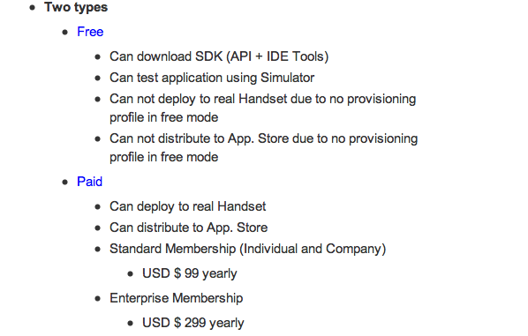
Apple development registration

Slide 6
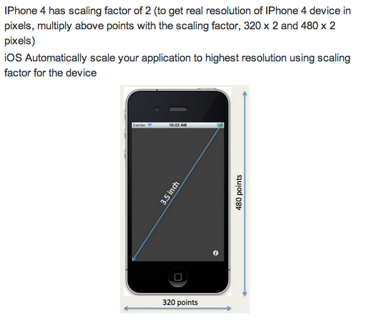
Display and Graphics

Slide 7
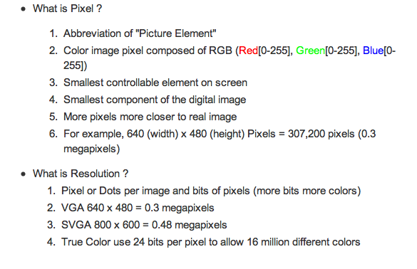
Pixels & Resolutions
ZOOM
7 pixel X 7 pixel = 49 pixel Resolution

Slide 8
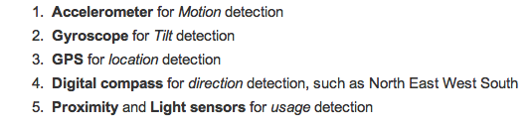
Supported hardware interfaces

Slide 9
Development tools
Xcode
Xcode is an Integrated Design Environment (IDE)
Source code editing, build, compile, debugging and more
Interface Builder
Use to Designing and Connecting GUI
Changes in IB are in sync with Xcode
Swift
Object Oriented Language

Slide 10
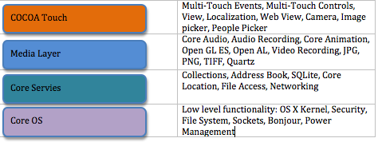
Architecture
Operating system that runs on iPhone, iPod touch, and iPad devices.
It manages the device hardware and provides the technologies required to implement native applications.
Upper Layer using services from the Lower Layer(s)

Slide 11
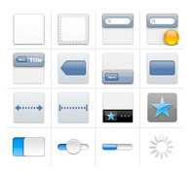
Frameworks
Cocoa Touch
Drives user interactions on
UI functions are available for development using this framework
Foundation
UIKit
UIKit is responsible for,
- Application UI Management
- Event Management
- Execution Management
Cocoa Touch is based on Cocoa, which is a object oriented API for the Mac OS X

Slide 12
Play Ground

Slide 13
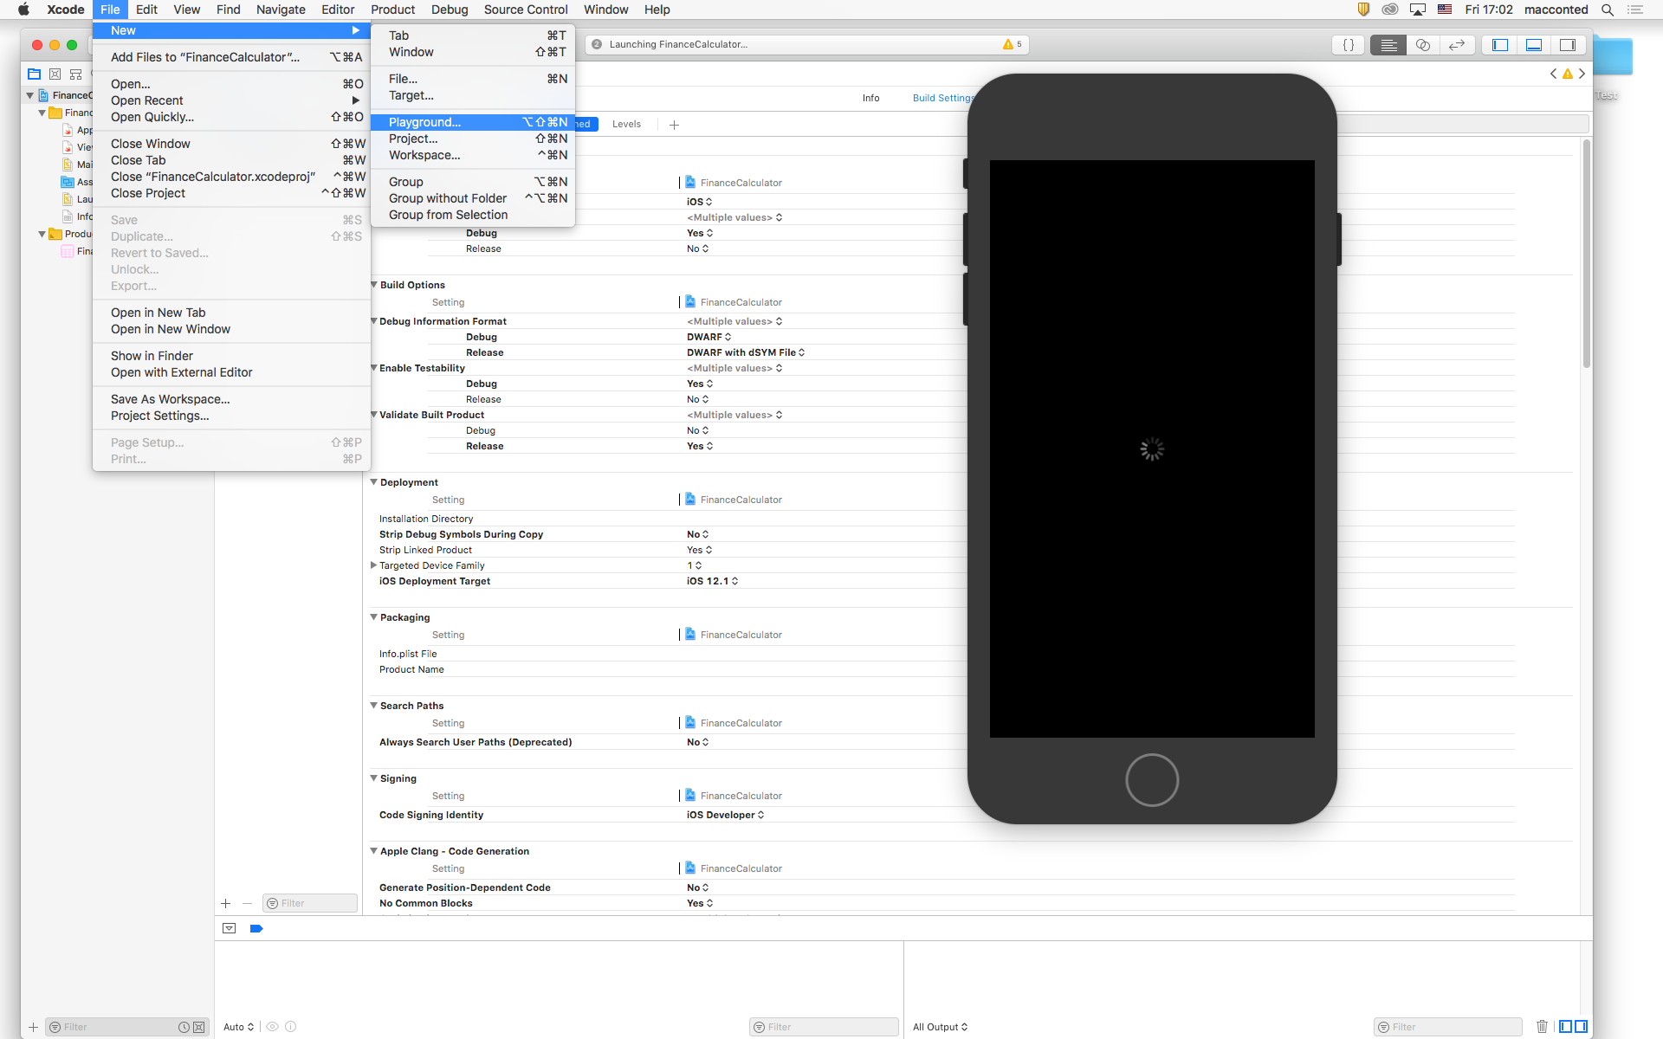
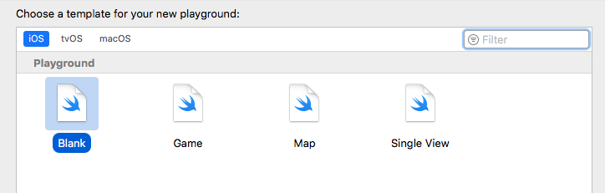
Create new PlayGround

Slide 14
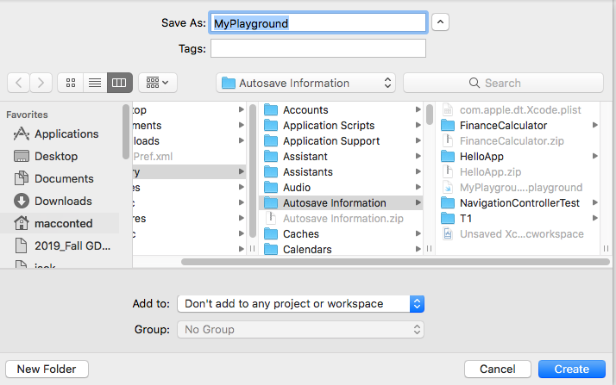
Save location

Slide 15
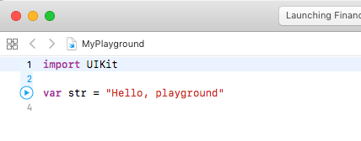
Default PlayGround Screen

Slide 16
Variable & Constant declaration
import UIKit
//1.declaring constants and variables
//1.1 Constants
let msg = "hello !"
print (msg)
//1.2Variables
var name : String = ""
print (name)
var address : String = "Tokyo"
print(address)
var email : String? = nil
print (email ?? "Unknown")
var age : Int? = nil
print (age ?? -1) //set default value after ??, which is 1

Slide 17
Using Optional
//below code crash due to email is still nil and can not be unwrapped with !, this is called forced unwrapped
//hench for safer execution if let block as shown later
//print(email!)
//print("Email Unwrapped : " + email!)
email = "my@email.com"
//if let block
if let myemail = email {
print("Email Unwrapped with let: " + myemail)
} else {
print ("Email is nil")
}

Slide 18
Class Declaration
class Player {
//must have init values
var id: String
var score : Int
init(id: String, score: Int) {
self.id = id
self.score = score
}
}
var player1 : Player = Player(id : "myid", score : 108)
print(player1.id)
print(player1.score)

Slide 19
Functions
//more about functions
//func = keyword, getMedalName = function name, distance = argument label (optional), with = paramater name, Double = parameter type, String = func return type
//declare function
func getMedalName(distance with : Double) -> String {
return "Gold"
}
//call function
var myMedal = getMedalName(distance : 200) //call with argument label, 200 is an argument
print (myMedal)

Slide 20
Function with multiple return values
func getCoordinates () -> (Double, Double) {
let x = 10.2
//x = 10 //not allowed as x is a constant
var y = 21.3
y = 57
return (x, y)
}
var xy = getCoordinates()
print(xy)
//declare function which will allow arument without specifying the argument label or paramater name
func getScore(_ id: String) -> Double {
print ("Returning score for the id \(id)")
return 97
}
var score = getScore("A7") //argument as a student's id
print(score)

Slide 21
Loops
//for in
for x in 1..<5 {
print ("Index is \(x)")
}
//var cityList : [String] = ["Tokyo" , "Osaka", "Nagoya"]
var cityList = ["Tokyo" , "Osaka", "Nagoya"]
for city in cityList {
print(city + " " , terminator:"") //terminator will print the output in one line
}
//while
var count = 1
while (count <= 3) {
print("Count is \(count)")
count = count + 1
}
//repeat (similar to do...while)

Slide 22
XCode & UI Development

Slide 23
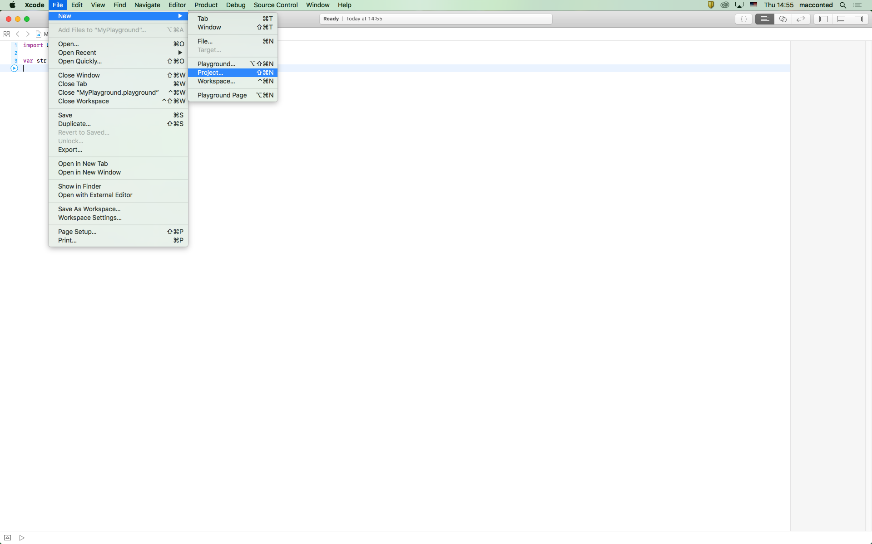
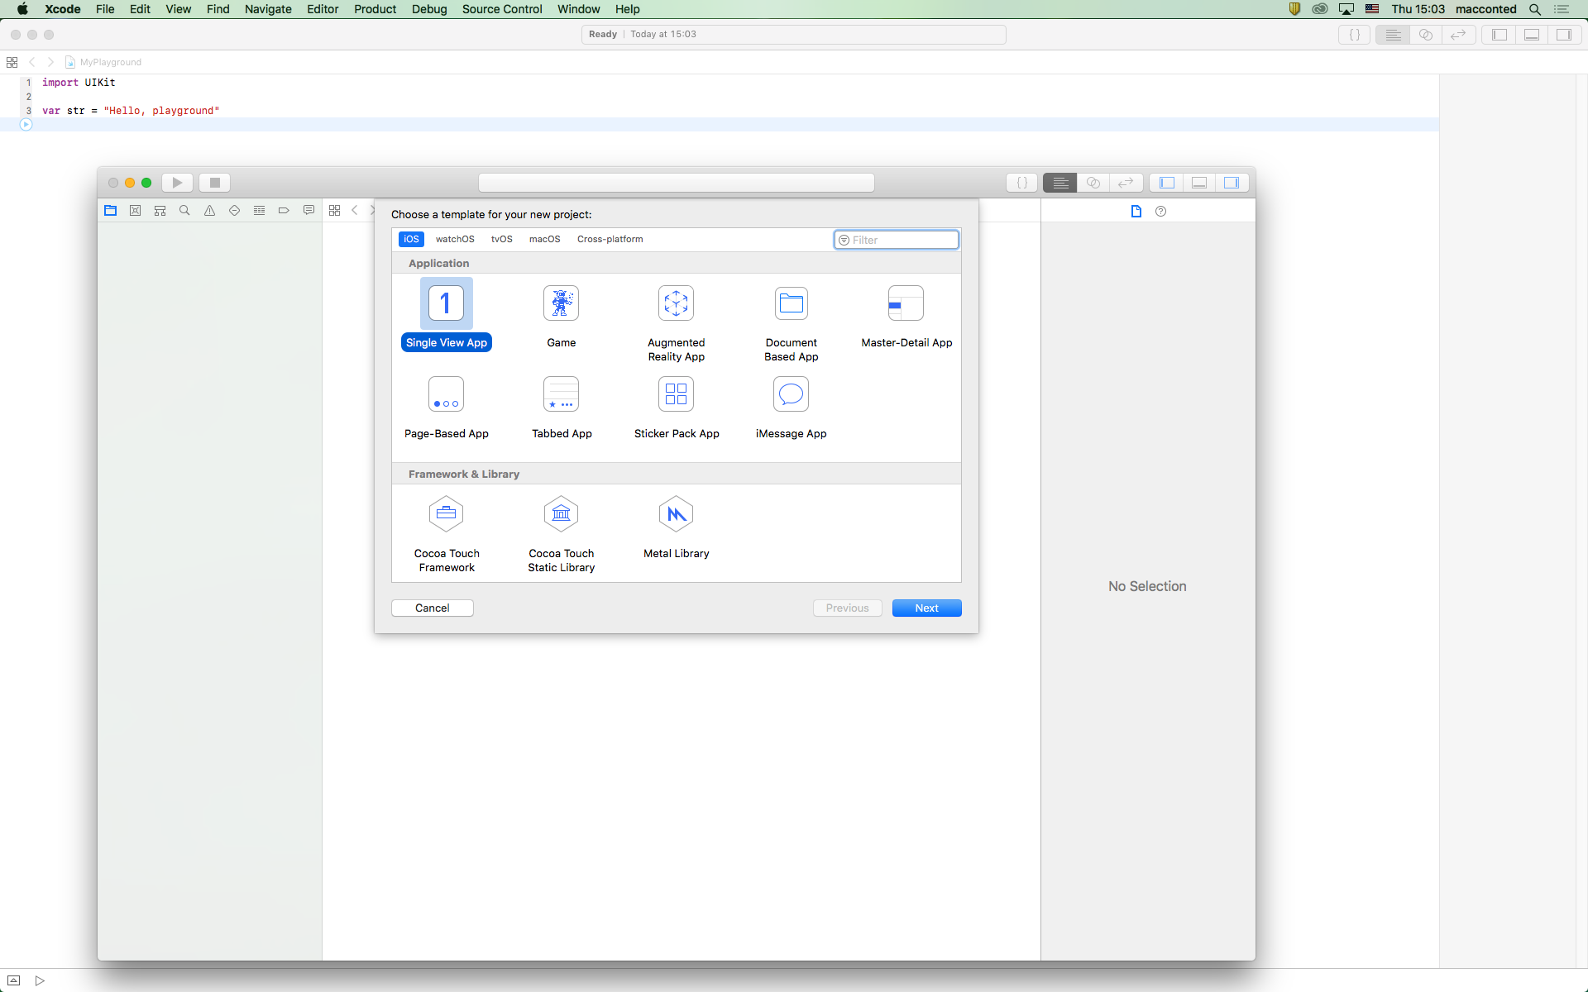
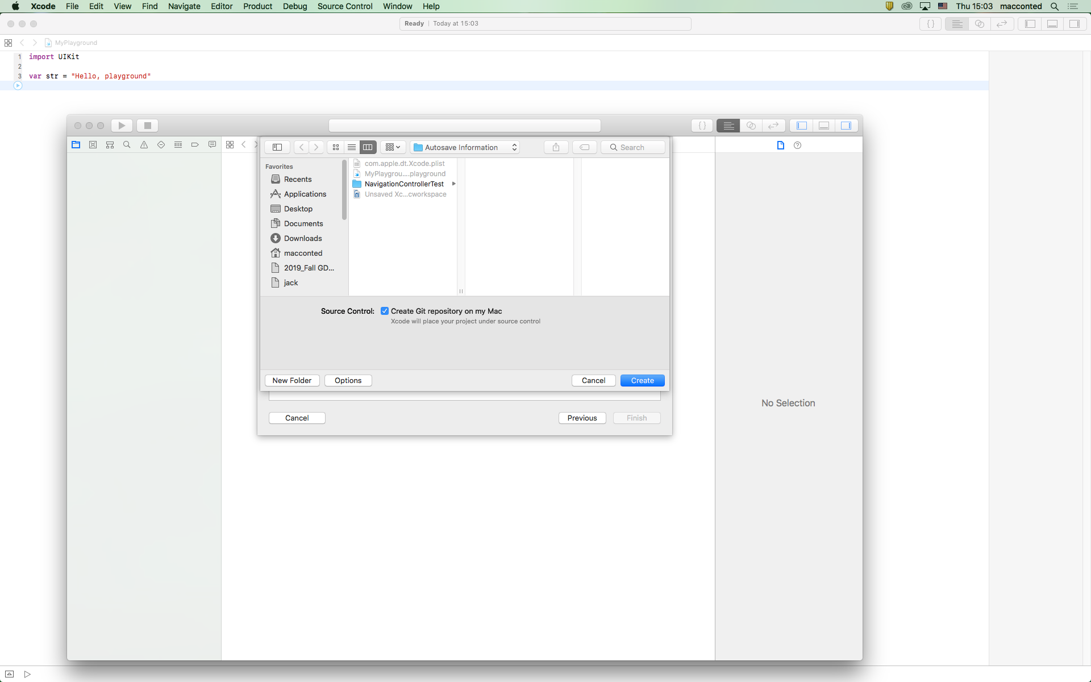
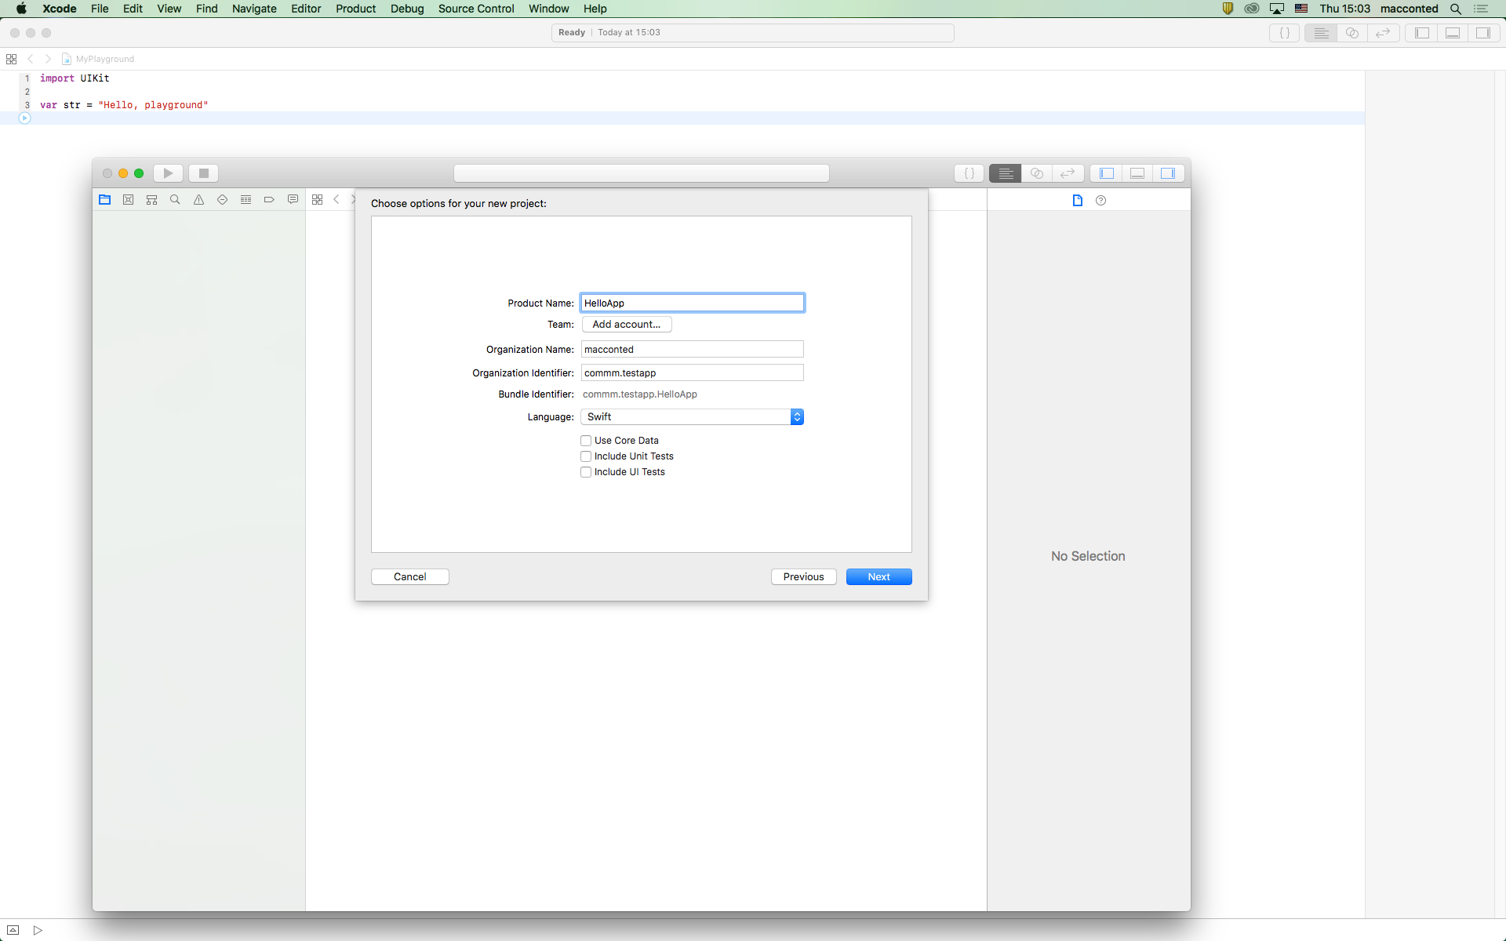
Create a new project

Slide 24
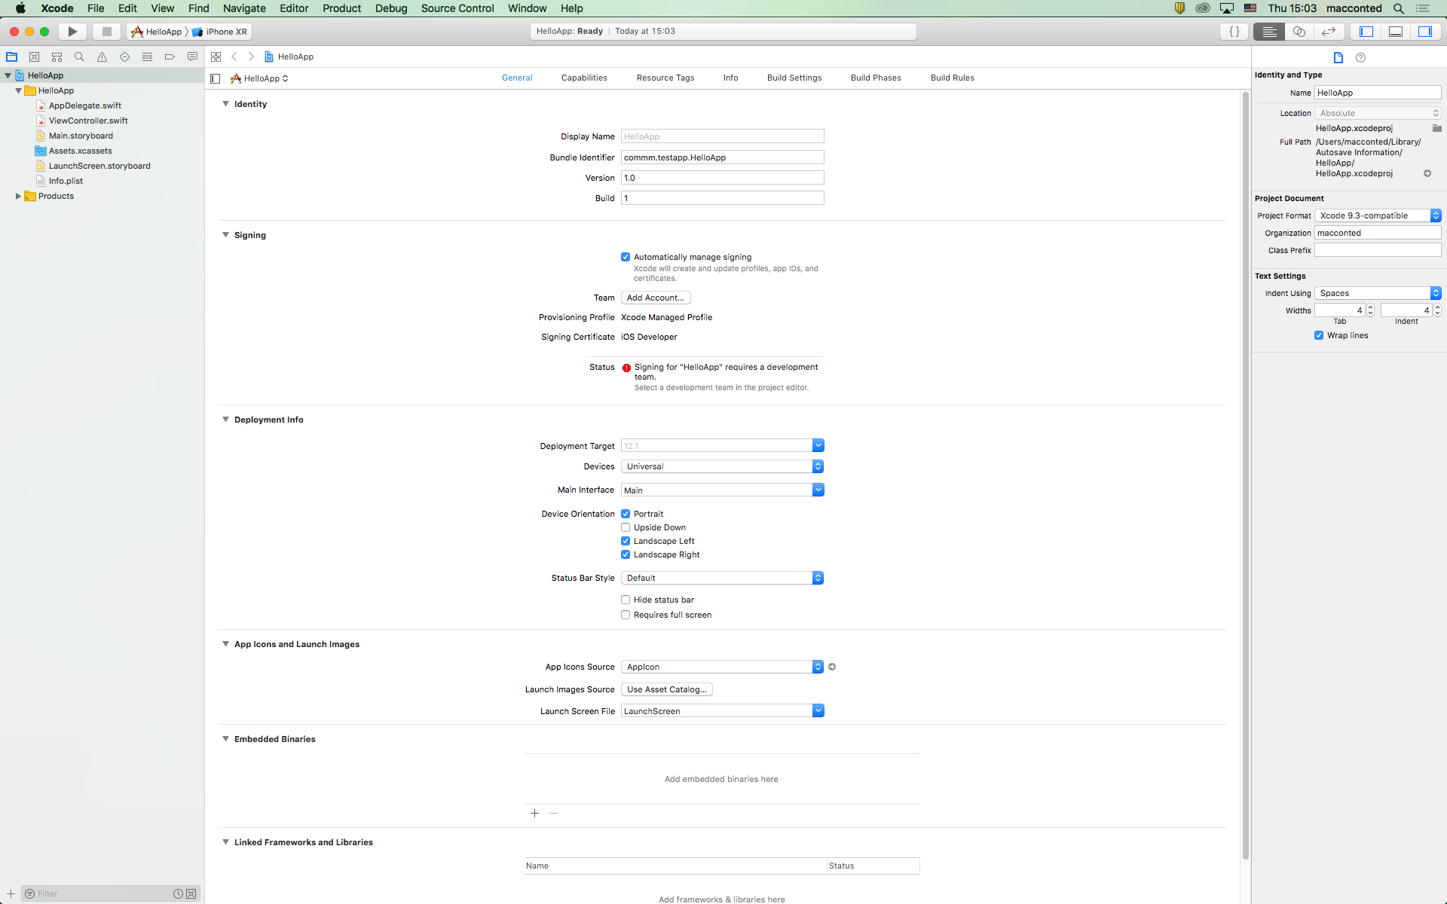
New project completion

Slide 25
Project structure

Slide 26
Project configuration

Slide 27
Project settings

Slide 28
Main storyboard

Slide 29
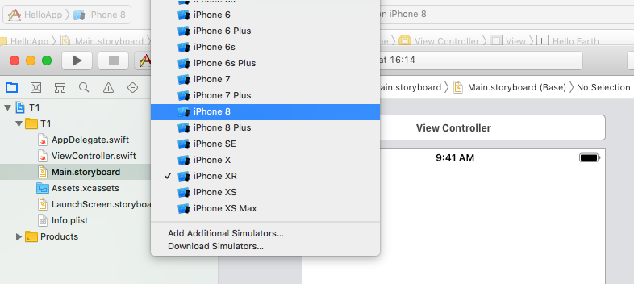
Select target device

Slide 30
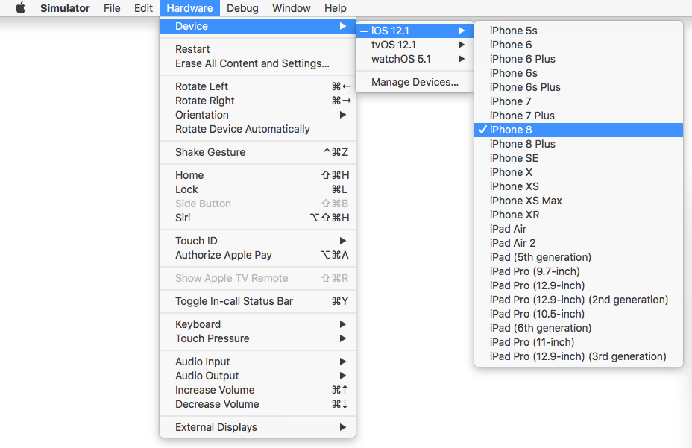
Simulator and device menu

Slide 31
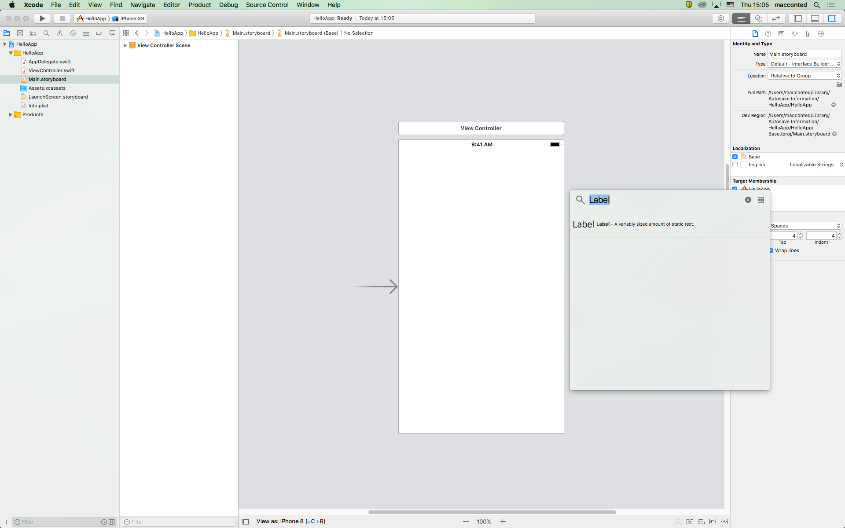
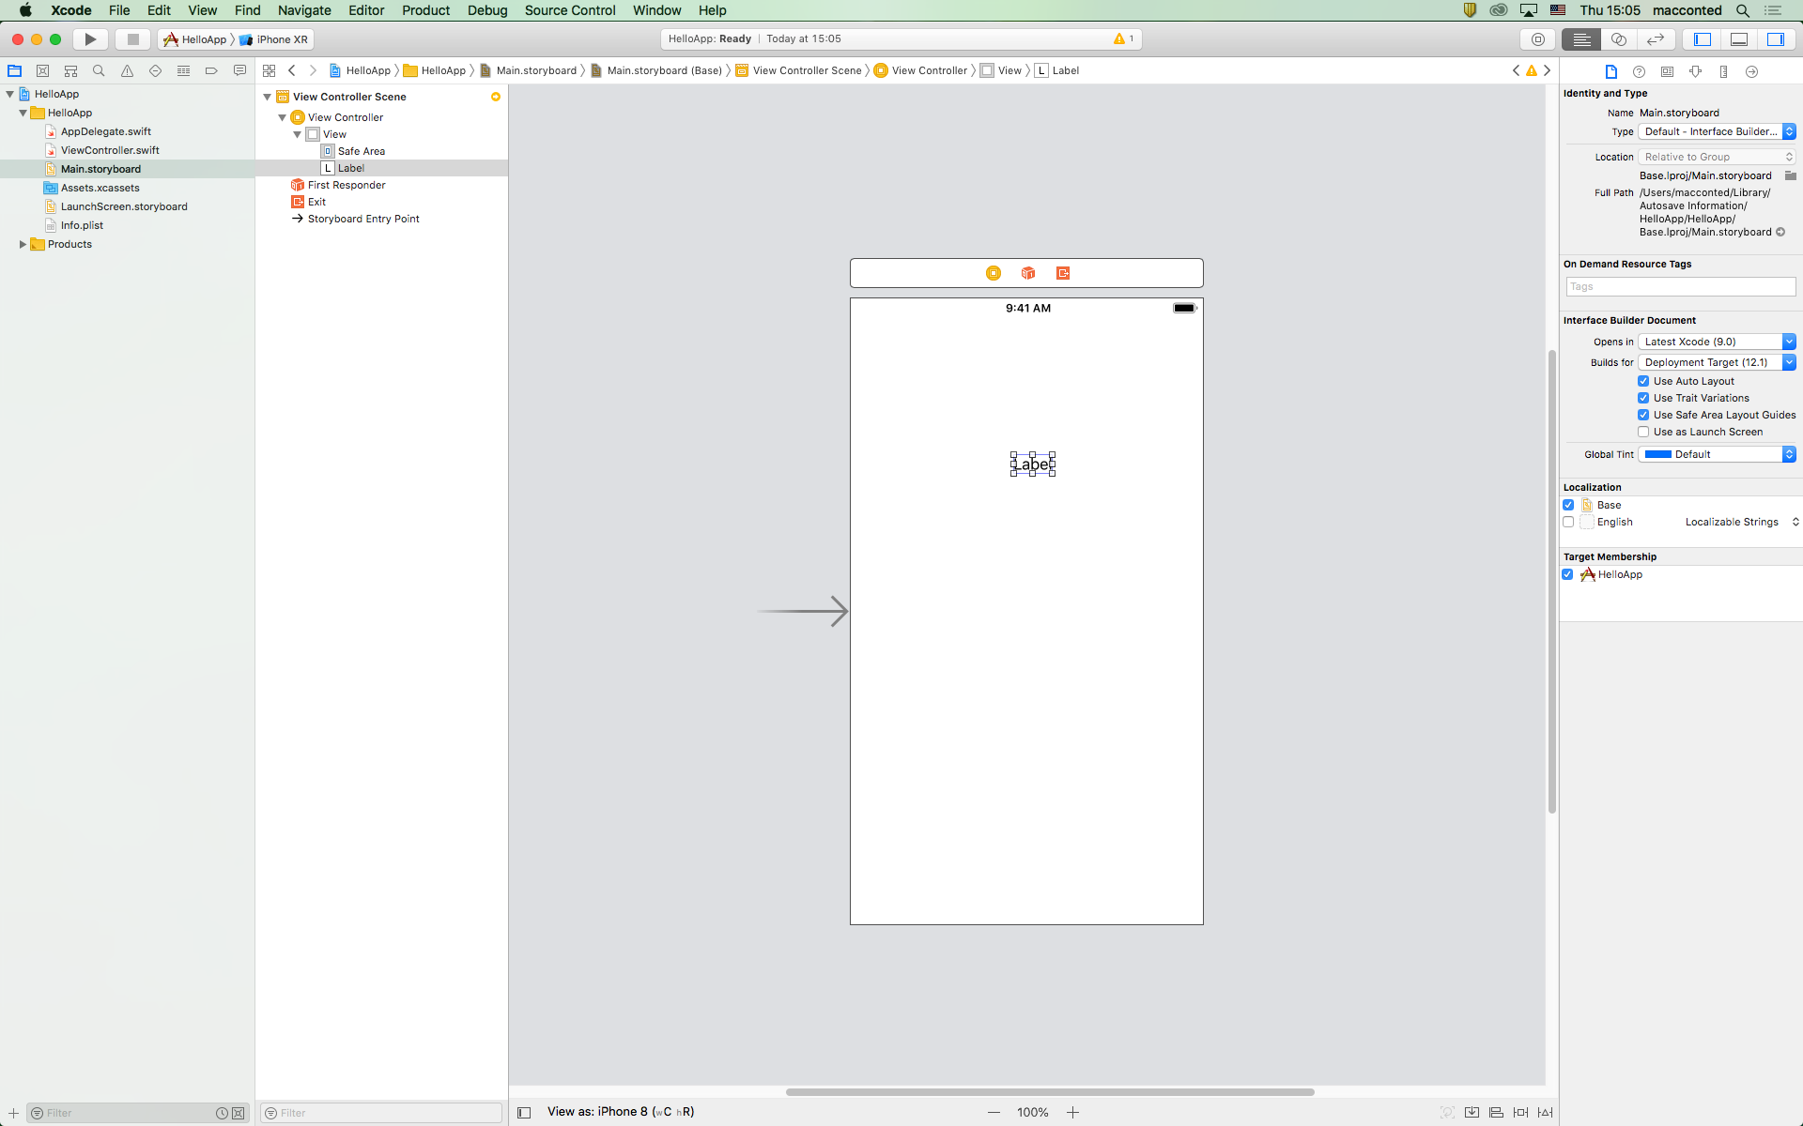
Add UI Label to the Main storyboard

Slide 32

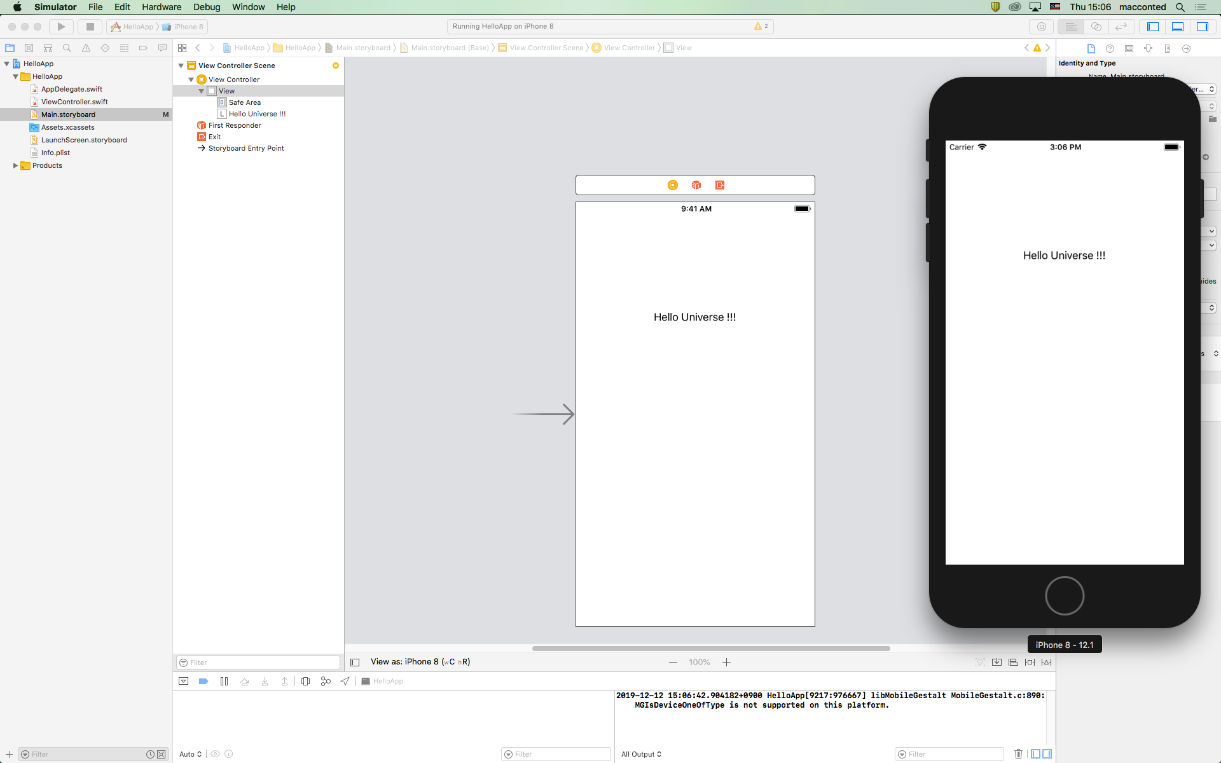
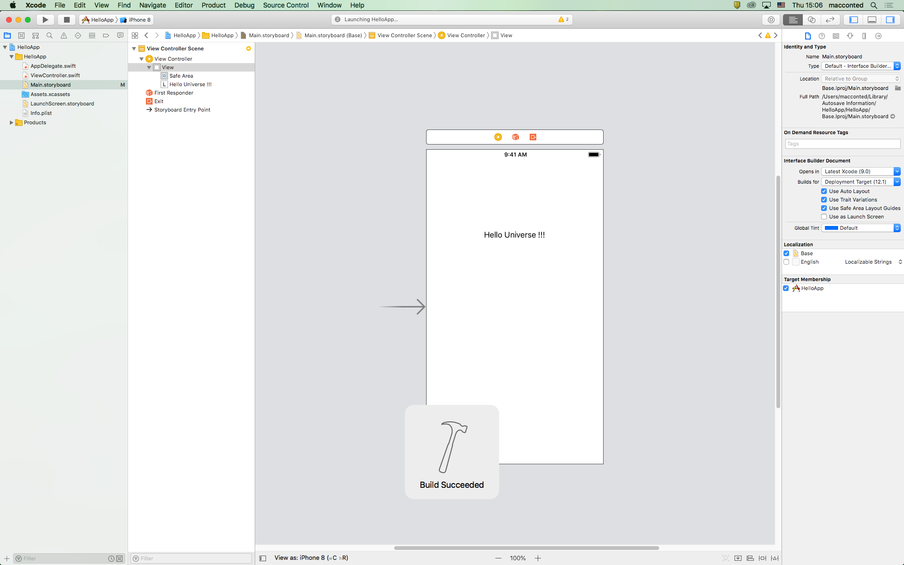
Change Run Check
1) Change Label Text
2) Run
3) Check with Simulator

Slide 33
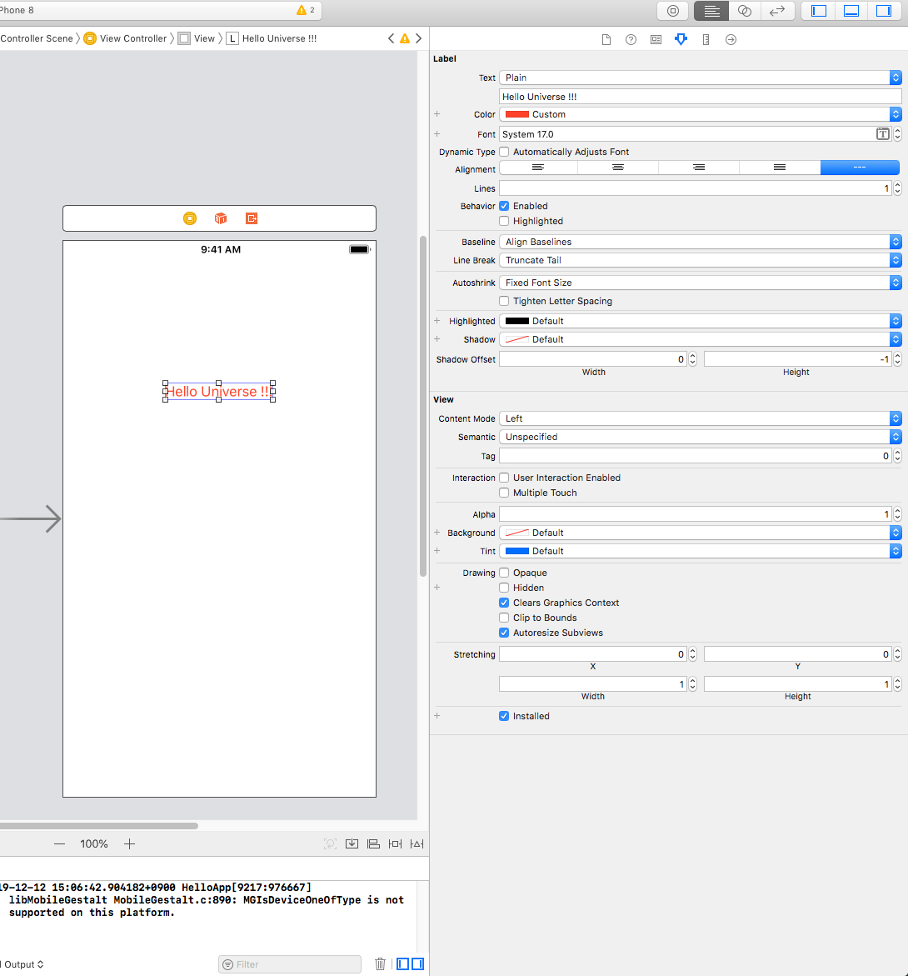
Change color of the UI Label

Slide 34
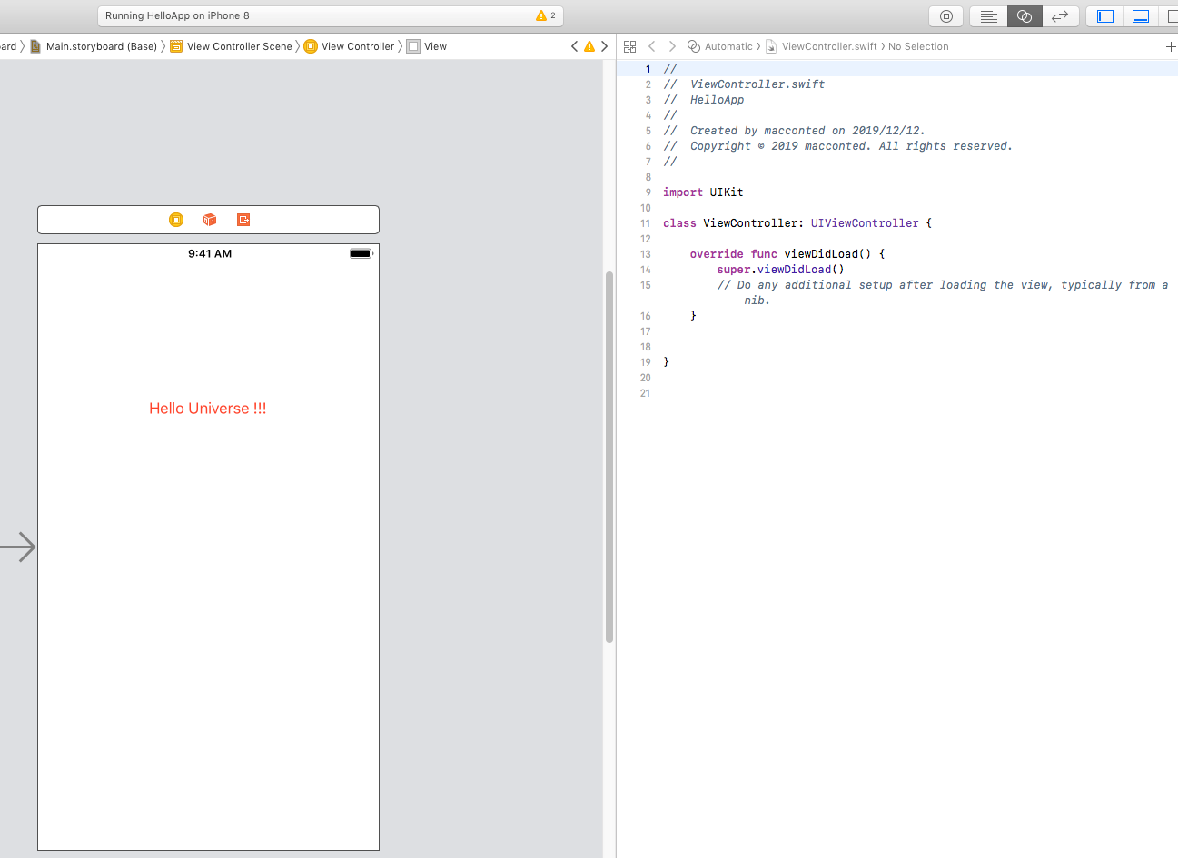
Assistant Editor

Slide 35
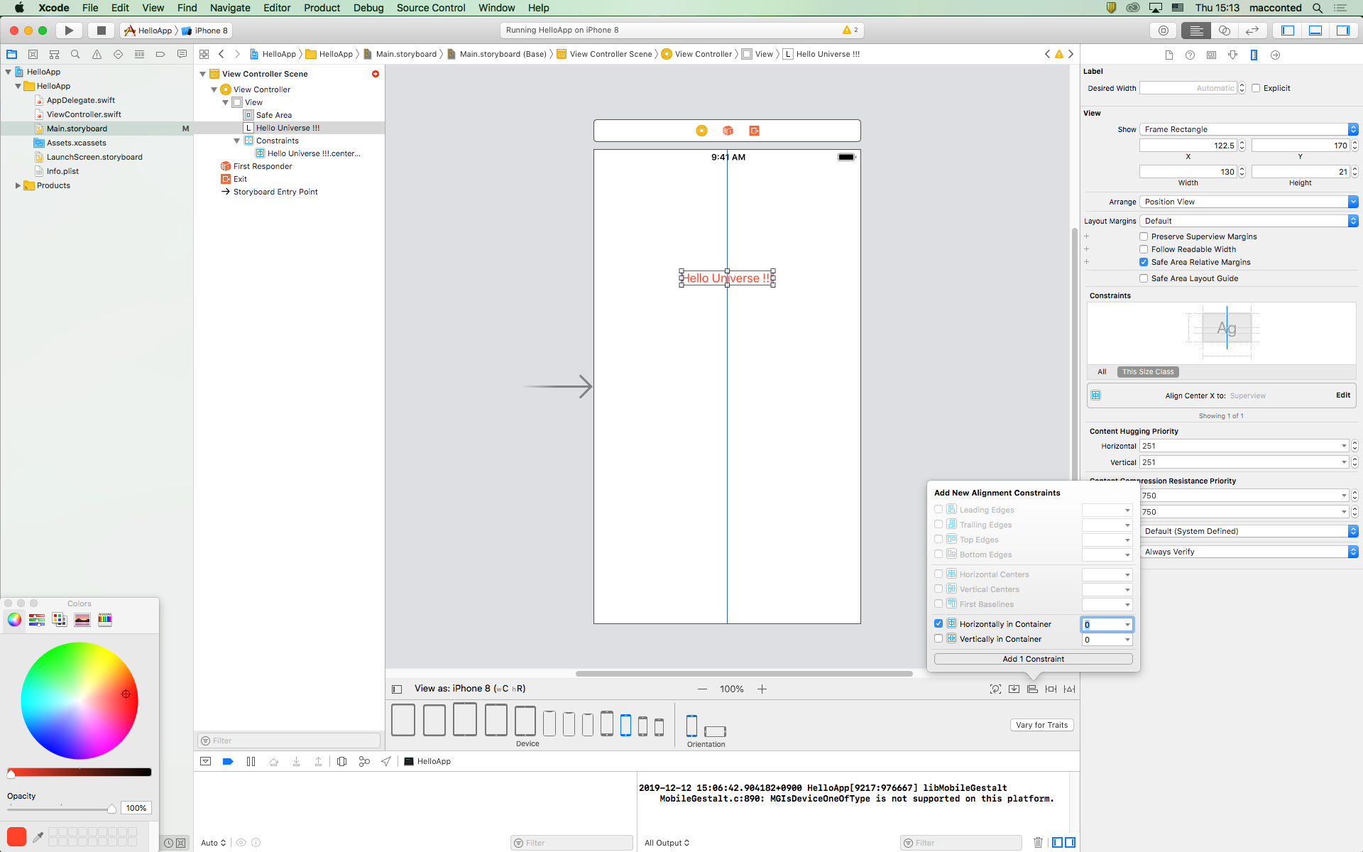
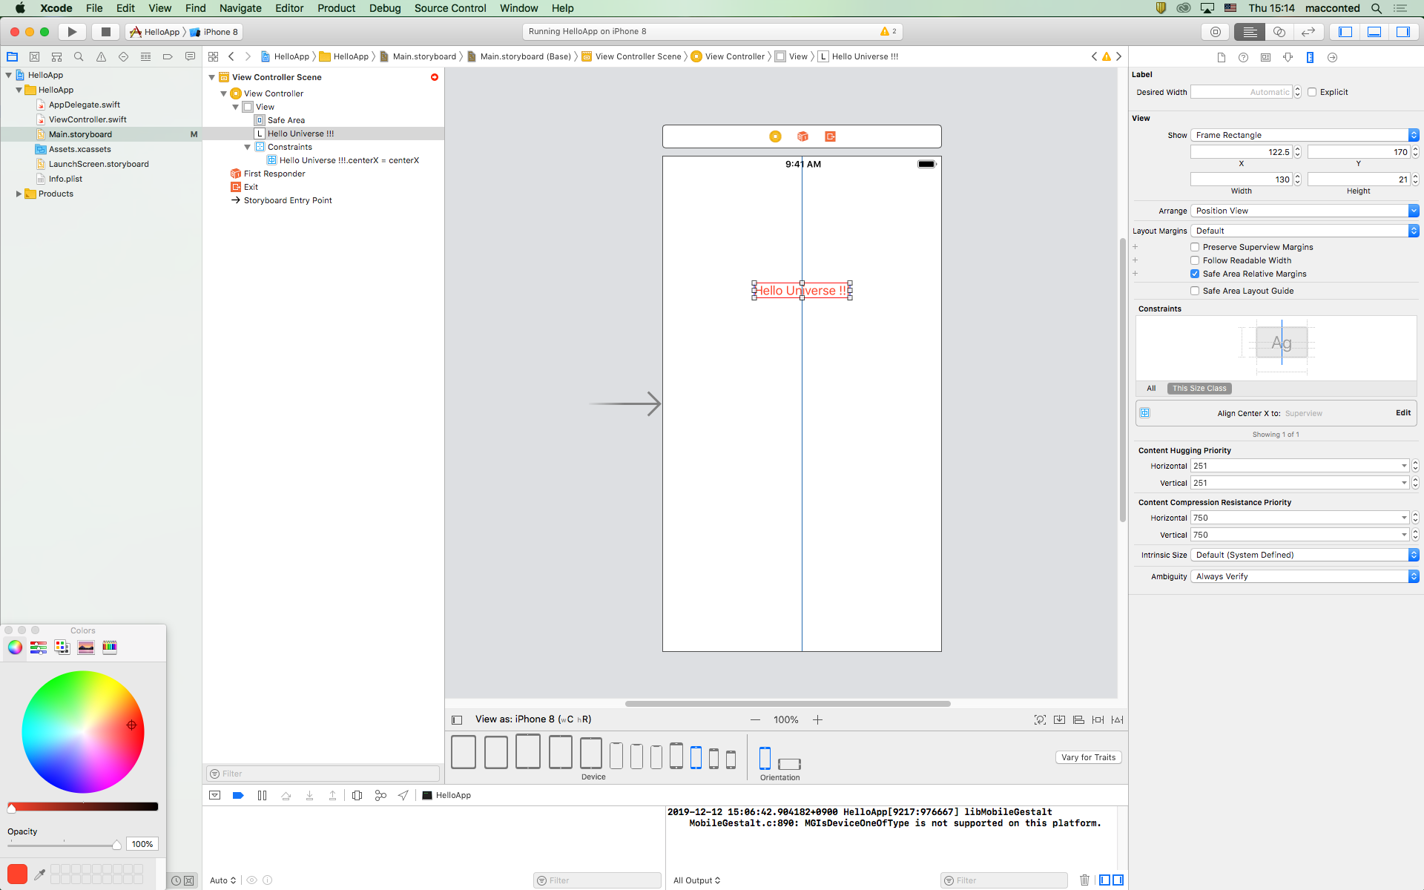
UI Label alignment using auto layout

Slide 36
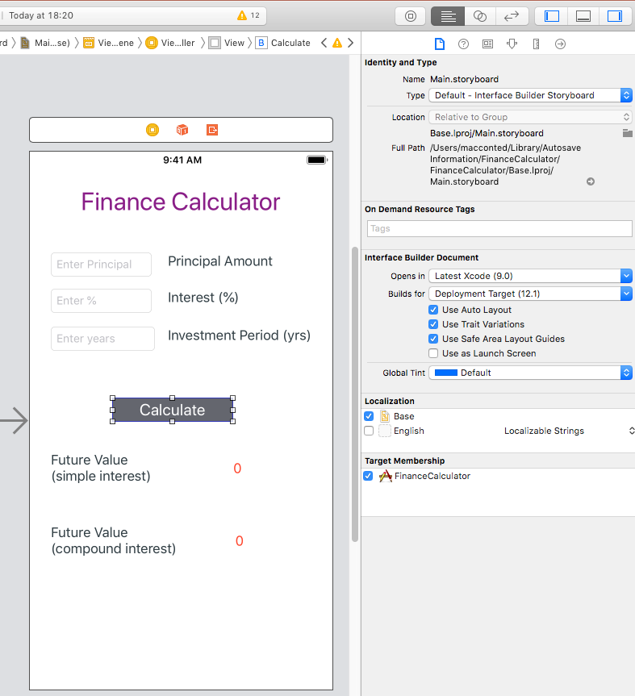
Component Inspectors

Slide 37
LAB 1 : Finance Calculator App

Slide 38
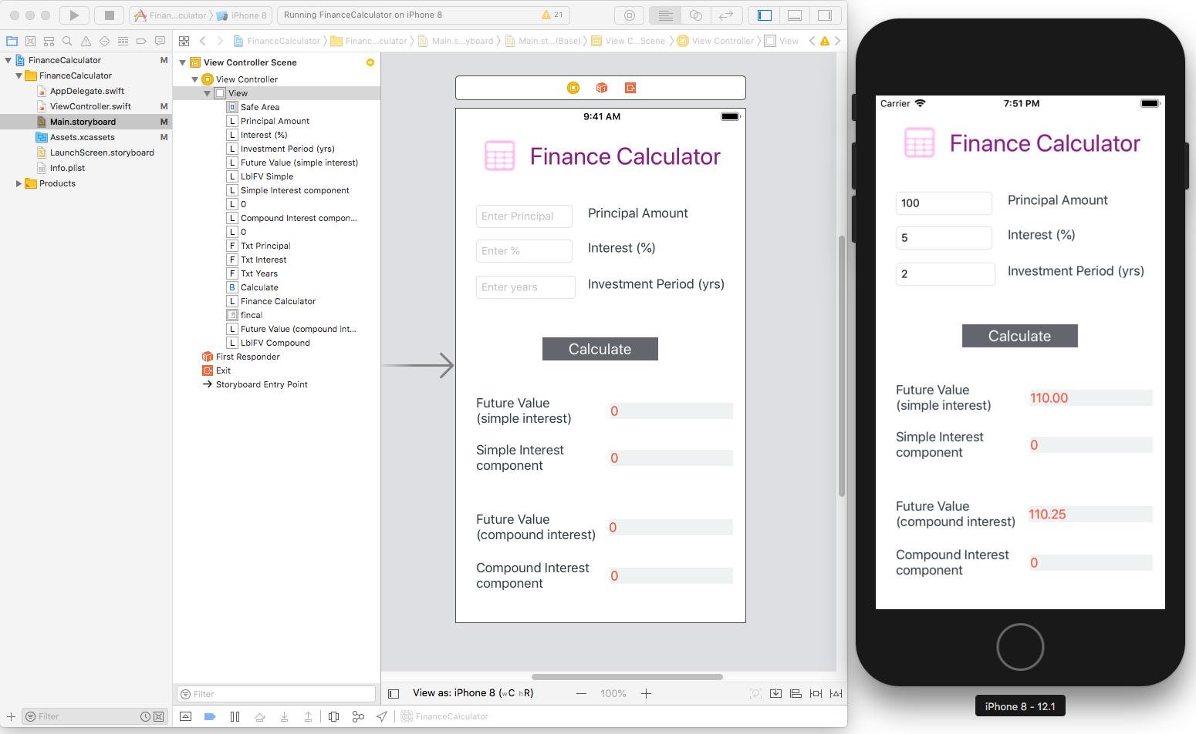
LAB 1 : Finance Calculator App

Slide 39
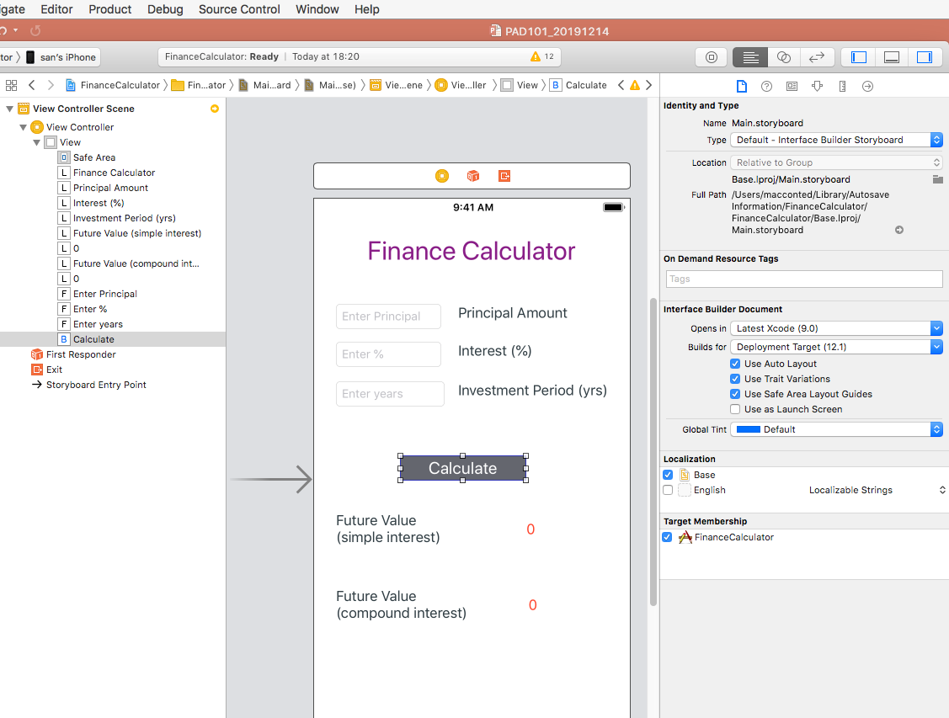
L1

Slide 40
L2

Slide 41
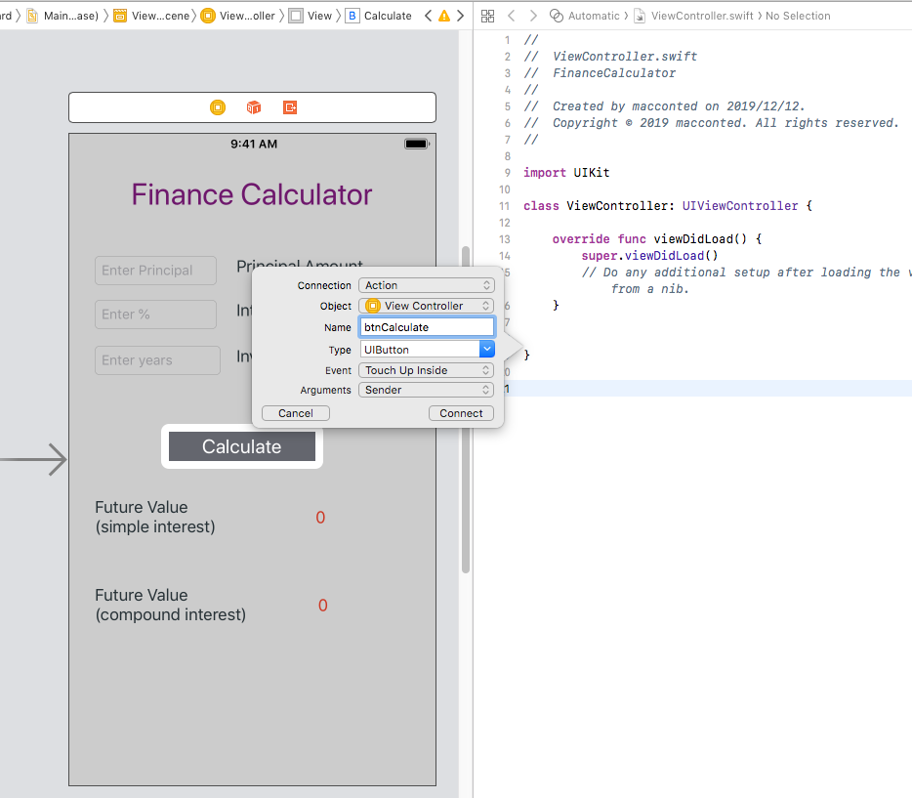
L3

Slide 42
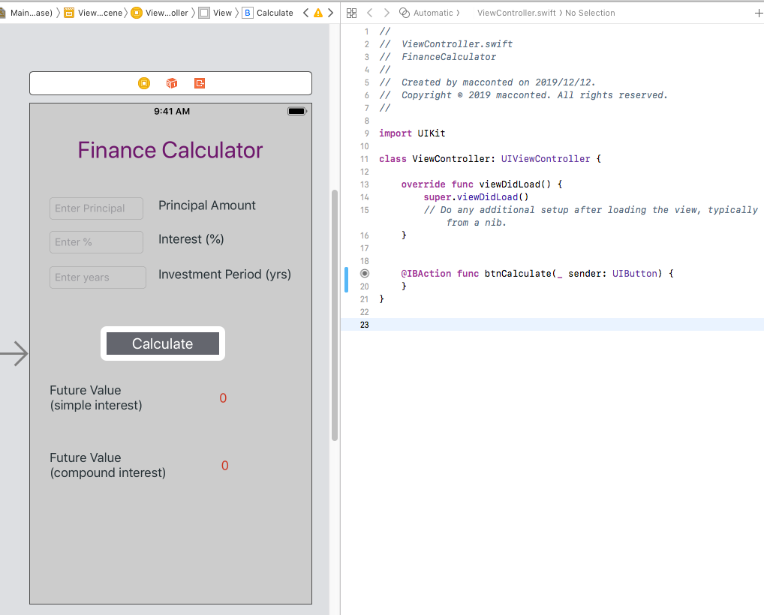
L4

Slide 43
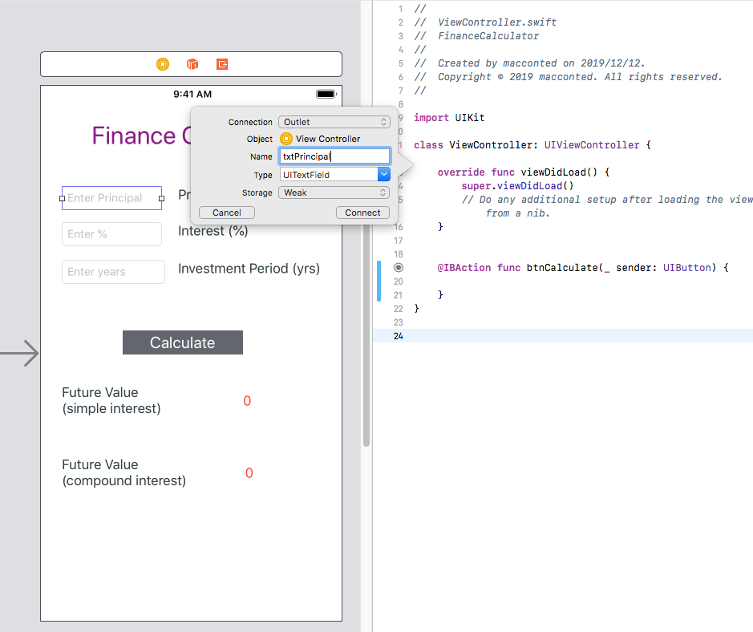
L5

Slide 44
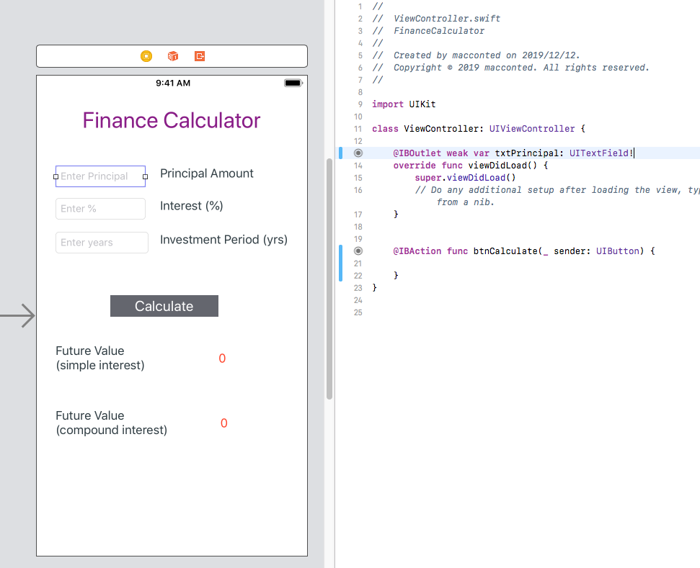
L6

Slide 45
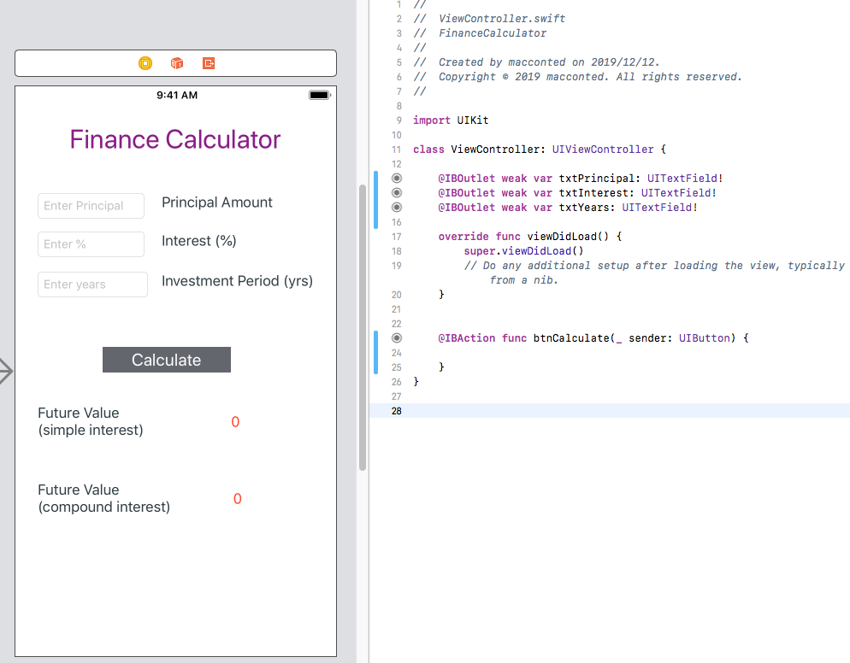
L7

Slide 46
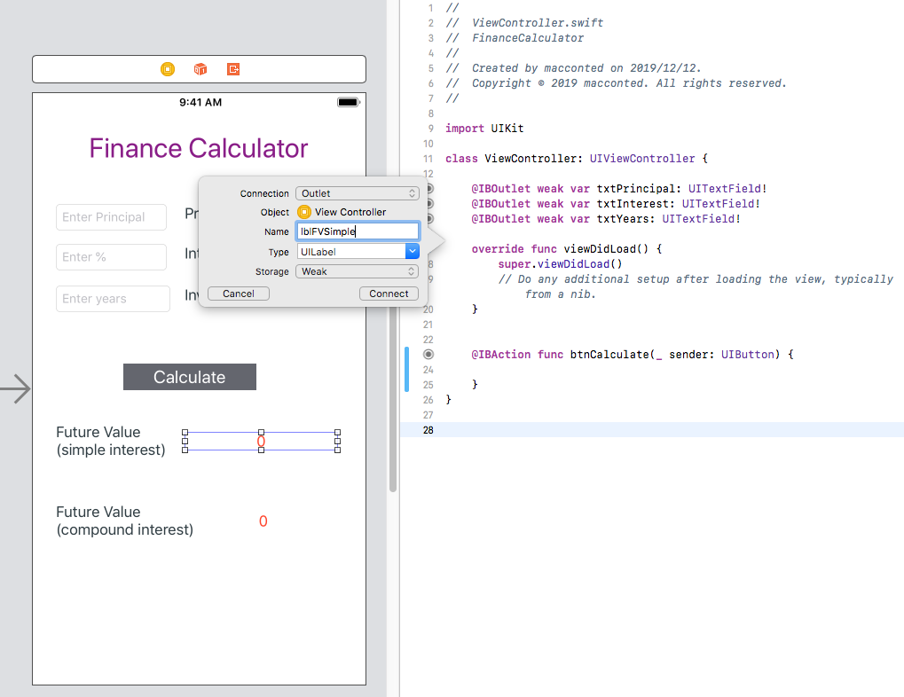
L8

Slide 47
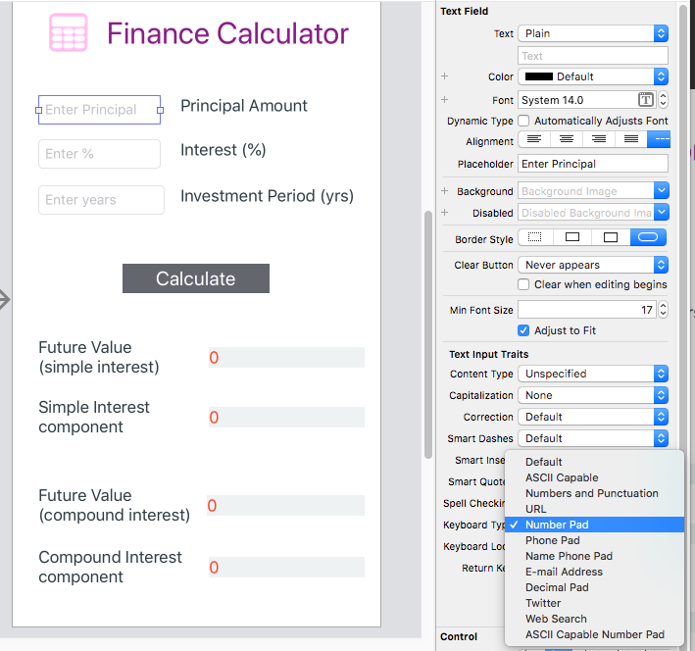
L9

Slide 48
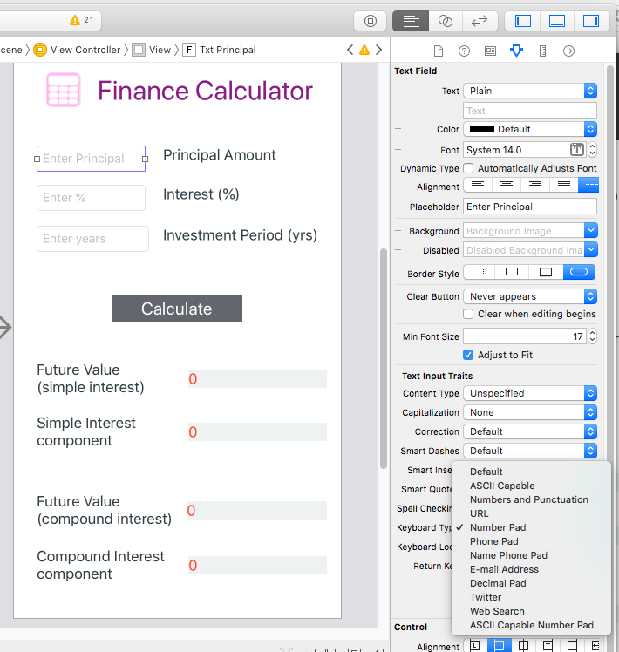
L10

Slide 49
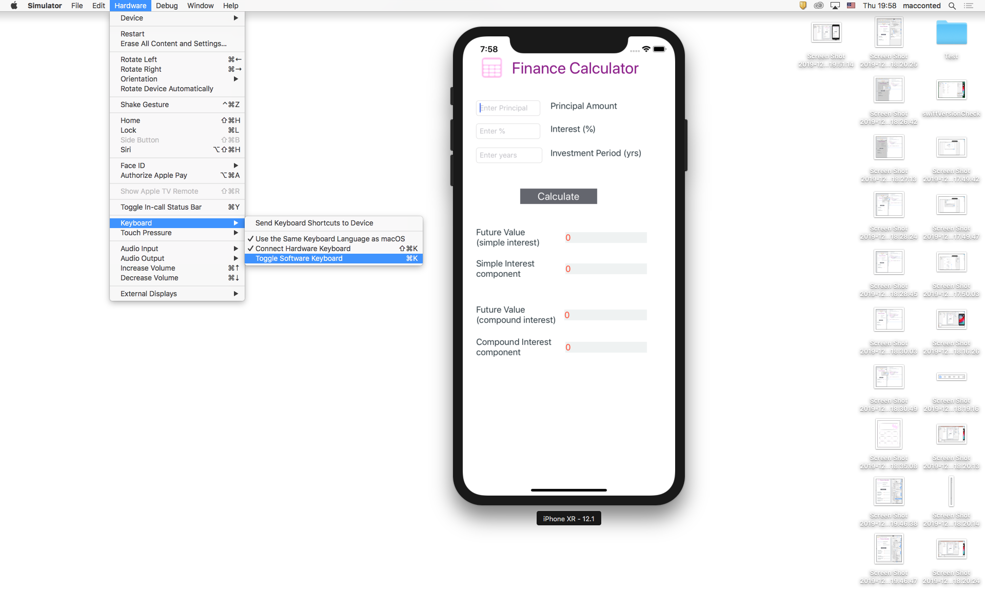
L11

Slide 50
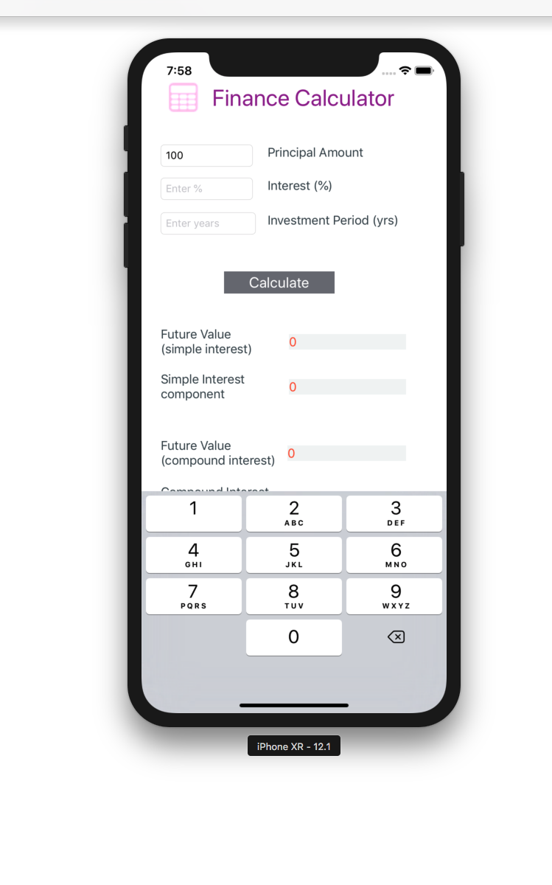
L1

Slide 51
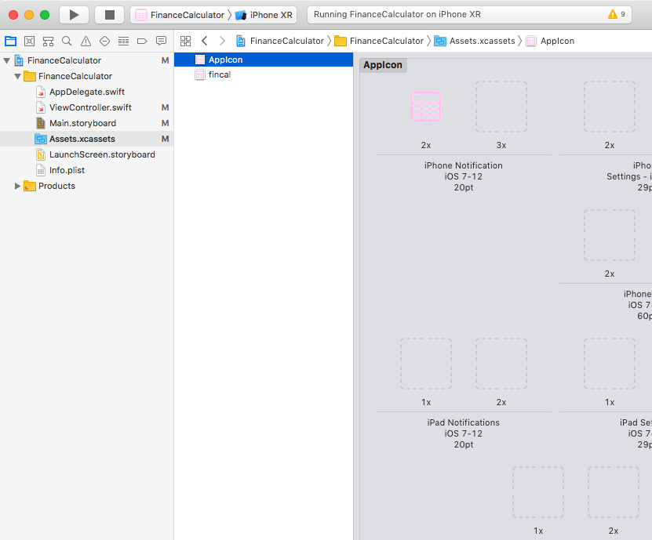
L1

